Slide 1



3rd International Conference on the Flat Dilatometer
Rome – Italy, June 14-16, 2015
G-γ stiffness degradation curves
by seismic dilatometer (SDMT)
Sara Amoroso (Istituto Nazionale di Geofisica e Vulcanologia, Italy)
sara.amoroso@ingv.it
Paola Monaco (University of L'Aquila, Italy)
paola.monaco@univaq.it

Slide 2
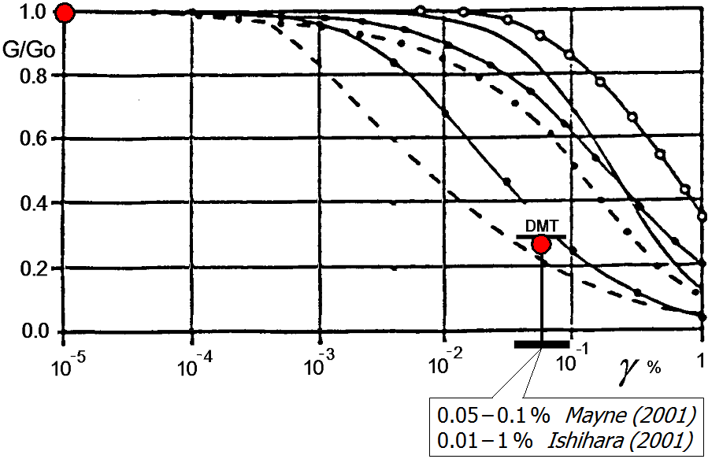
Tentative method for deriving in situ
G-γ decay curves from SDMT
SDMT  small strain modulus G₀ from V_{S}
working strain modulus G_{DMT} from M_{DMT}
(track record DMT-predicted vs. measured settlements)
?
But which γ
associated to G_{DMT} ?

Slide 3
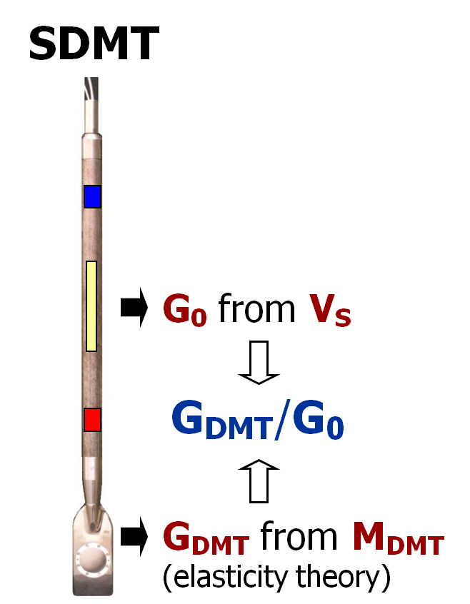
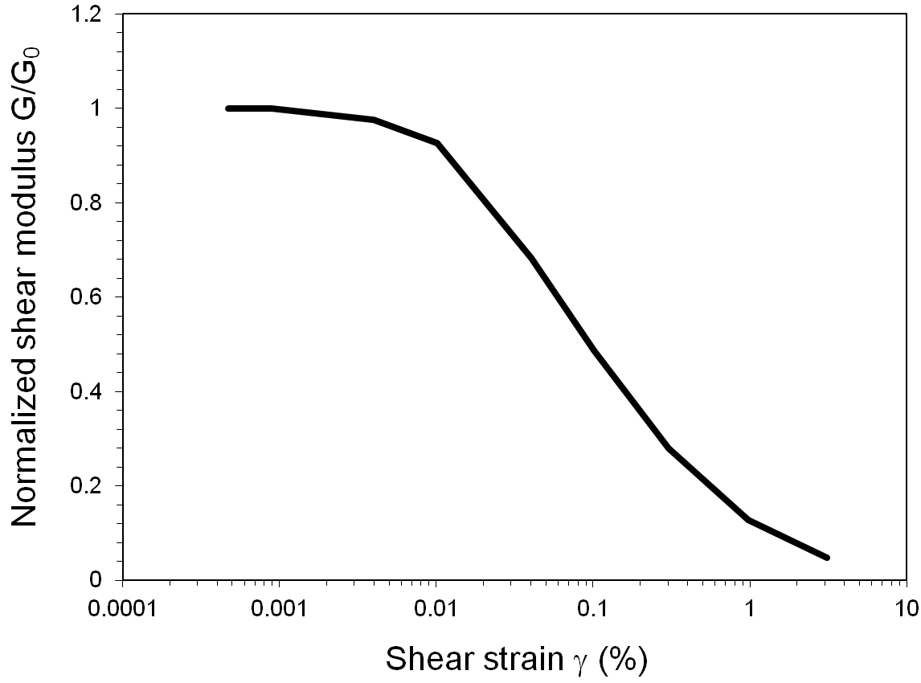

Shear strain "γ_{DMT}"
Quantitative indications by comparing at various test sites and in different soil types SDMT data + “reference” stiffness decay curves:
back-figured from the observed behavior under a full-scale test embankment (Treporti) or footings (Texas)
obtained by laboratory tests (L'Aquila, Po plain, Fucino plain)
reconstructed by combining different in situ/laboratory techniques (Western Australia)
same-depth "reference" stiffness decay curve

Slide 4
Treporti – Test Site Embankment
DMT
DMT
Monaco et al. (2014)
E = K_{E} p_{a} (σ'_{v} /p_{a} ) ^{0.5}
Normalized decay curves of soil stiffness with vertical strain back-calculated from local ε_{v} measurements in the soil under the embankment, at 1 m depth intervals, provided by sliding deformeters ("In situ curves") and their intersection with data points corresponding to same-depth DMT moduli E_{DMT}: (a) sand 2-8 m, (b) silt 8-20 m

Slide 5
Texas A&M University – National Geotechnical Experimentation Site
1994 Spread Footing Prediction Symposium
medium dense silty fine sand
Gibbens & Briaud (1994)
Stiffness decay curve E'/E₀ vs. relative displacement w/B (Berardi 1999) and superimposed E_{DMT}/E₀ data points

Slide 6
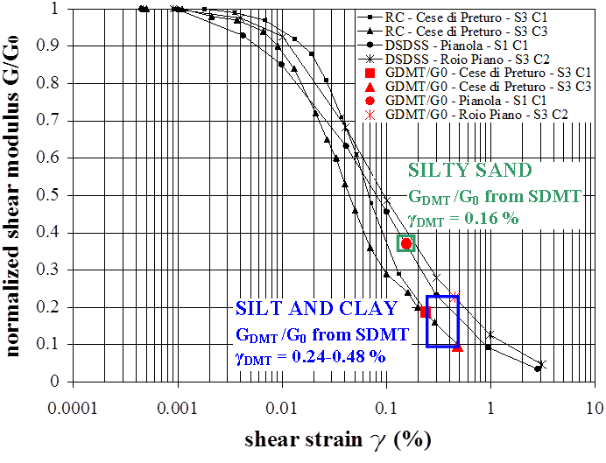
L'Aquila – 2009 Post-Earthquake Investigations
C.A.S.E. Project Test Sites
Santucci de Magistris et al. (2013)
Laboratory G/G₀-γ curves and superimposed G_{DMT}/G₀ data points
RC-CTS: UniNA Federico II (Italy)
DSDSS: UniRoma La Sapienza (Italy)

Slide 7
Po plain – 2009 Post-Earthquake Investigations
San Carlo (FE)
Working Group S2-UR4 (2013)
Laboratory G/G₀-γ curves and superimposed G_{DMT}/G₀ data points
RC-CTS: undisturbed samples in silty sand, silt and clay

Slide 8
Fucino plain – National Geotechnical
Research Site
Burghignoli et al. (1991)
Laboratory G/G₀-γ curves and superimposed G_{DMT}/G₀ data points
RC-CTS:12 undisturbed samples recovered between 3-37 m

Slide 9
Western Australia – Various test sites
In situ G/G₀-γ decay curves and superimposed G_{DMT}/G₀ data points:
(a) Shenton Park (siliceous sand) and Ledge Point (calcareous sand) (b) Perth CBD (silty clay)
(Amoroso 2011)

Slide 10
Western Australia – Various test sites
In situ G/G₀-γ decay curve and superimposed G_{DMT}/G₀ data points:
East Perth (soft clay), Margaret River (silty clay)
(Amoroso 2011)

Slide 11
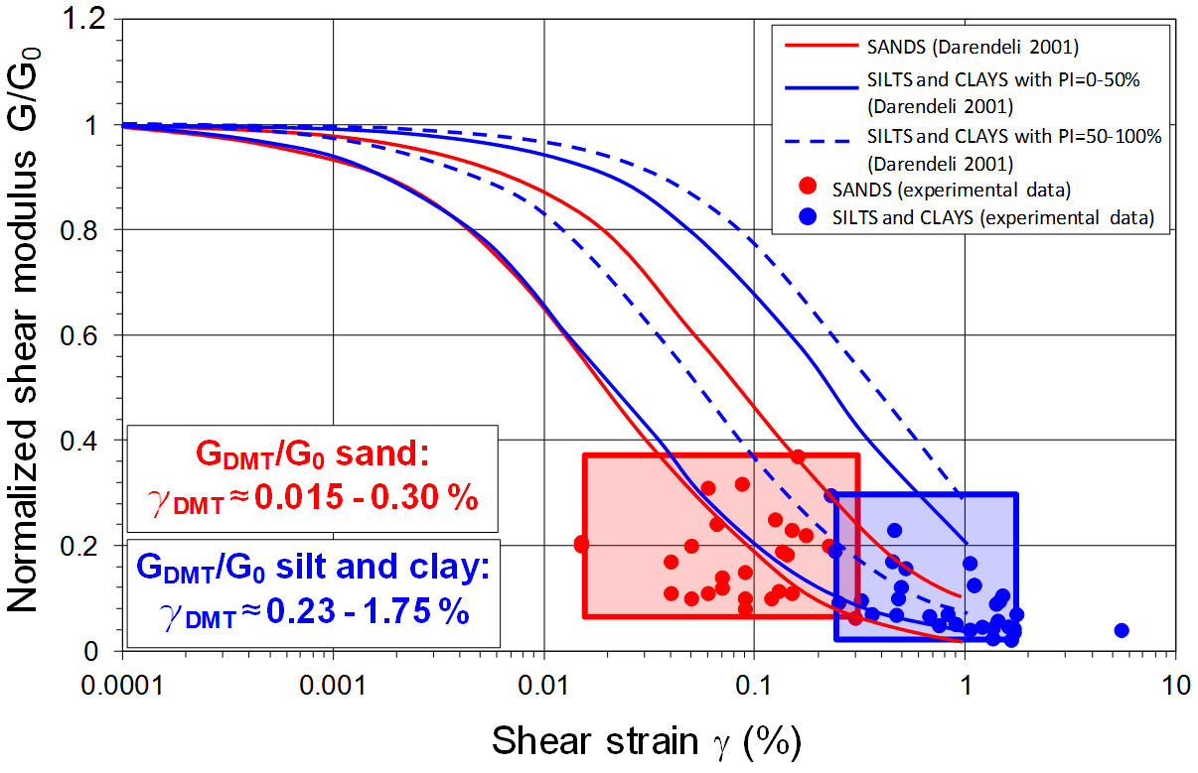
Typical ranges of γ_{DMT} in different soil types
"Typical shape" G/G₀-γ curves in different soil types
Amoroso et al. (2014)
Range of values of G_{DMT}/G₀ and corresponding shear strain γ_{DMT} determined by the "intersection" procedure in different soil types

Slide 12
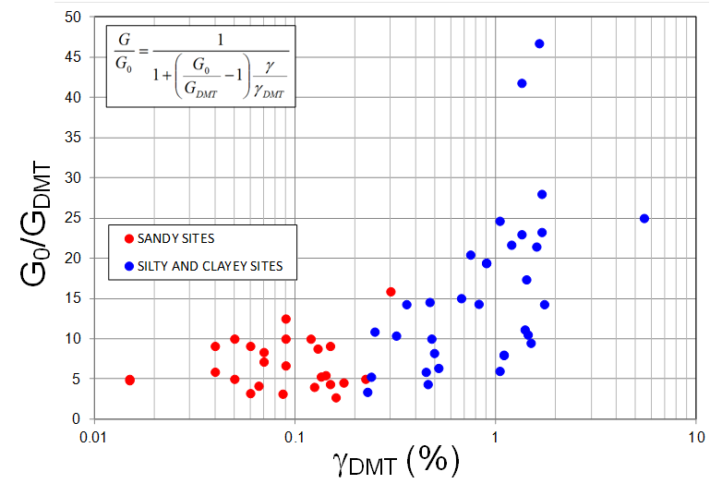
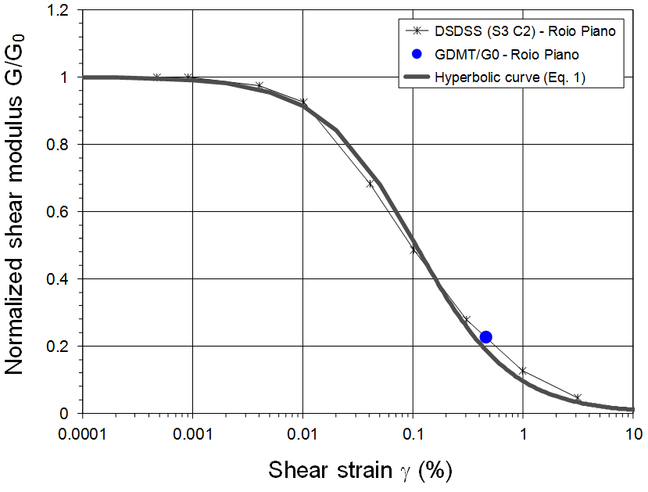
Tentative equation for deriving
G/G₀-γ curves from SDMT
SDMT data points used to assist construction of hyperbolic equation
Roio Piano – L'Aquila
Comparison between G/G₀ -γ decay curves obtained in Lab and estimated from SDMT by hyperbolic equation
DSDSS (Double Sample Direct Simple Shear tests): University of Roma La Sapienza
Amoroso et al. (2014)

Slide 13
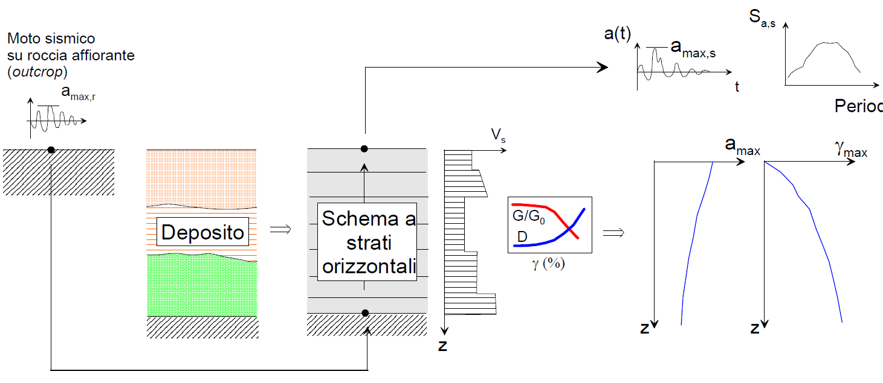
Numerical site seismic response analysis Schematic plot (1D) & typical results
TIME DOMAIN RESPONSE
FREQUENCY DOMAIN RESPONSE
INPUT
GROUND MOTION
(rock outcrop)
OUTPUT
GROUND MOTION
(ground surface)
Period, T
HORIZONTAL SOIL LAYERS
(1D model)
DEPOSIT
BEDROCK
SDMT

Slide 14
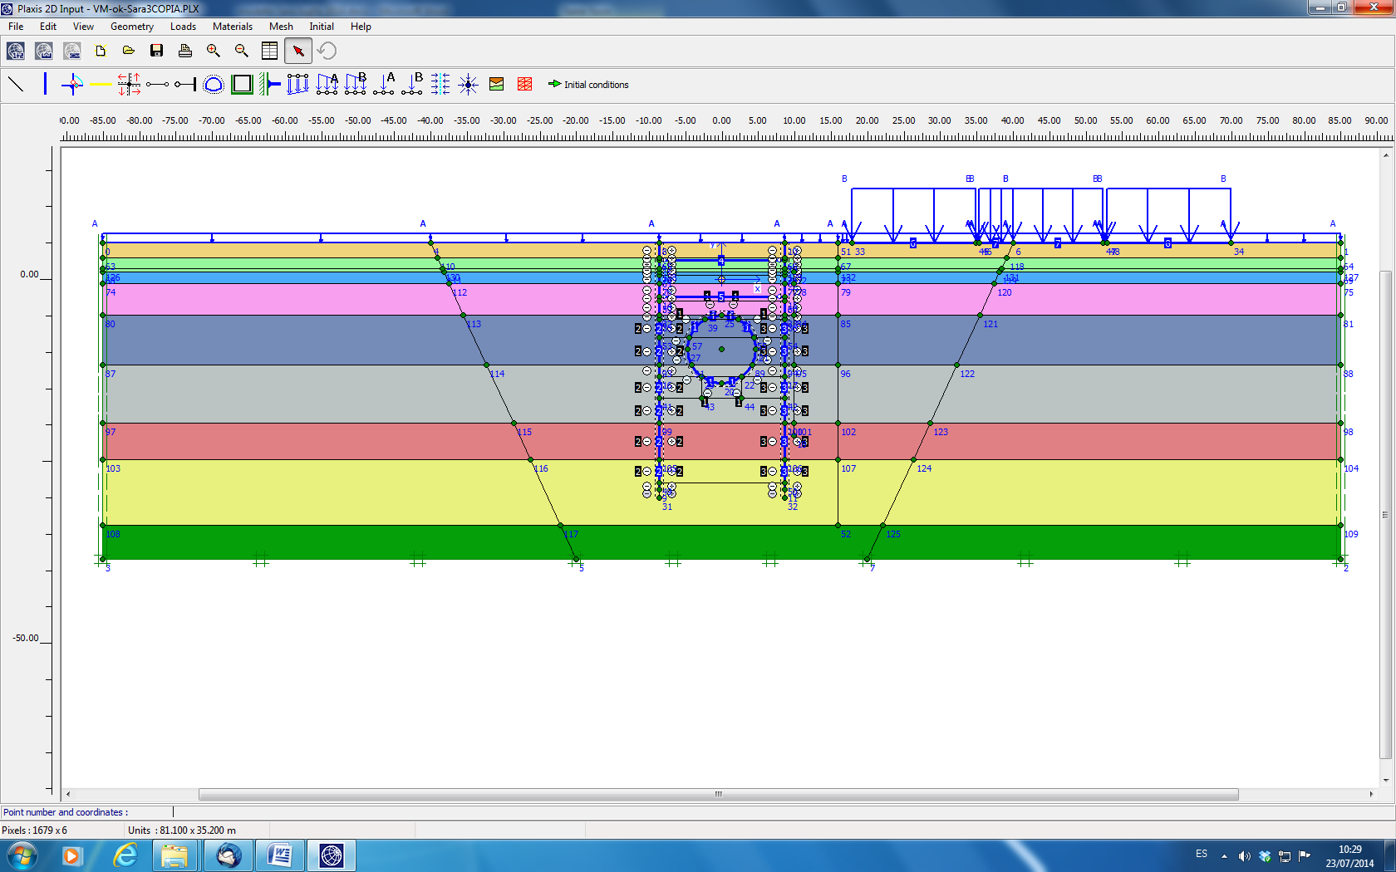
Validation of in situ G-γ decay curves
from SDMT (under study)
Comparison between HSS model – PLAXIS from SDMT parameters and monitoring activities for the excavation of Verge de Montserrat Station (Barcelona, Spain)
Working group: Amoroso, Arroyo, Gens, Monaco, Di Mariano

Slide 15
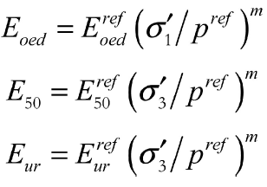
Validation of in situ G-γ decay curves
from SDMT (under study)
HSS model – PLAXIS
Assumptions:
G/G₀ = 0.722
γ_{0.7}

Slide 16
Validation of in situ G-γ decay curves
from SDMT (under study)
Preliminary results show an acceptable agreement between experimental data (monitoring activities) and numerical analysis (based on SDMT data)
Phase 9
“Pumping down
to a depth of 10 m”
Working group:
Amoroso, Arroyo, Gens, Monaco, Di Mariano

Slide 17
Concluding remarks
SDMT results could be used to assess the decay of in situ stiffness with strain level and to provide guidance in selecting G-γ curves in various soil types, thanks to its ability to provide both a small strain modulus (G₀ from V_{S}) and a working strain modulus G_{DMT} (obtained from M_{DMT} derived by usual DMT interpretation)
Use of proposed hyperbolic relationship, which requires to input ratio G_{DMT}/G₀ + presumed "typical" shear strain γ_{DMT} for a given soil type, can provide a useful first order estimate of G/G₀ -γ curves from SDMT (further validation needed)

Slide 18
Thank you for your attention

